Slide 1

Azure Active Hands-On Lab: Application Integration
Brett Hacker
Cloud Solution Architect, US NSO

Slide 2
Demo/Overview
https://localhost:44320/
https://adfsmvc.appservice.local.azurestack.external/
https://angtest.z13.web.core.windows.net/
https://wut.nu/

Slide 3
Step by Step
Create Tenant
Create MVC app
Create App Registration
Update MVC app
Add app registration configuration
Run and Login
Update code to inspect tokens

Slide 4
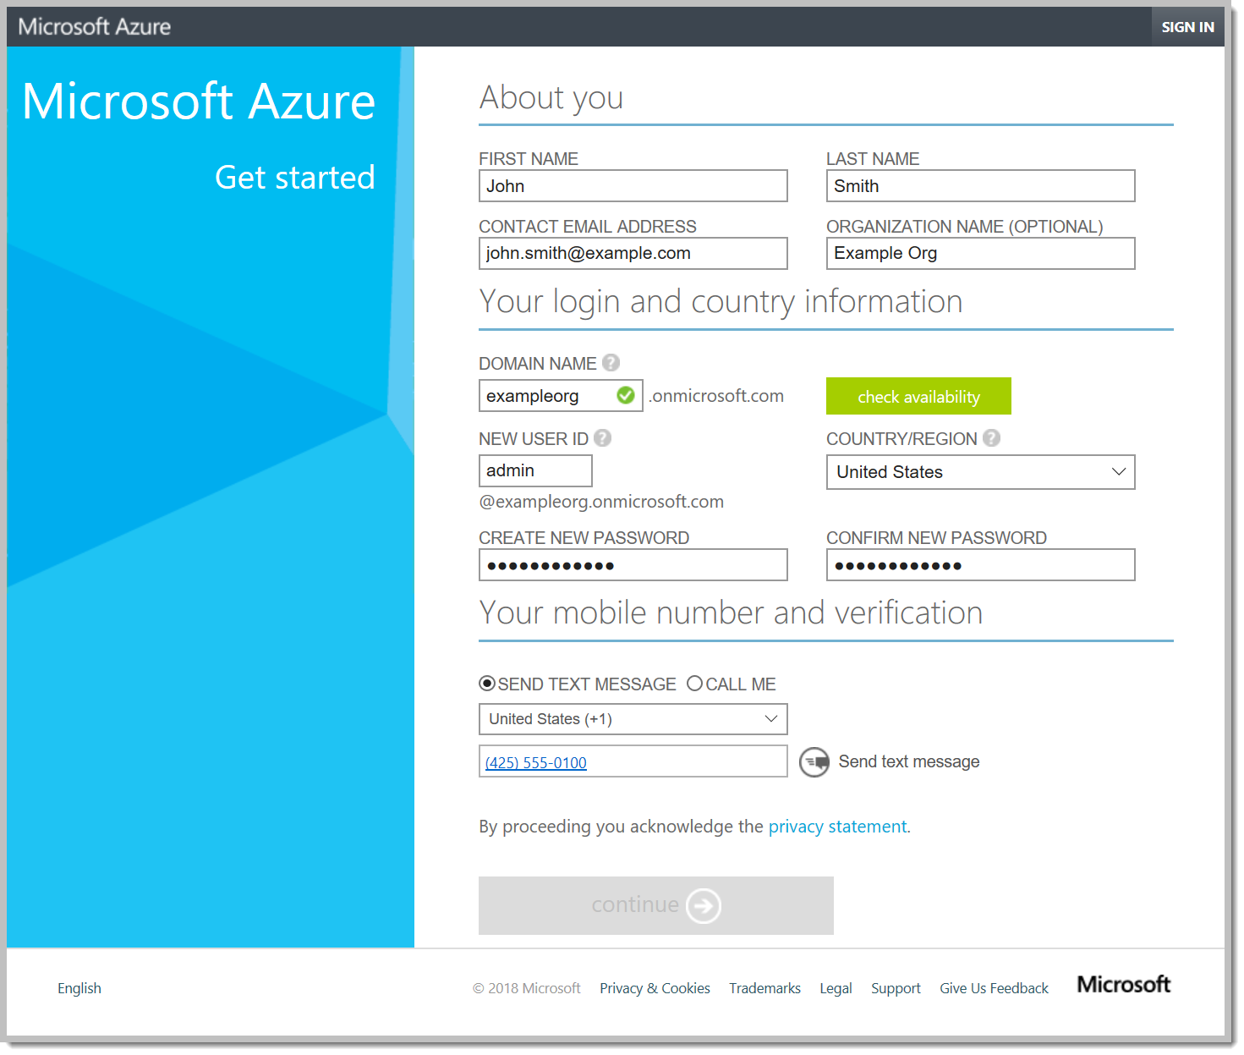
(optional) Get A Fresh Tenant
https://account.windowsazure.com/organization
Doesn’t require a subscription
Starts with stand-alone cloud-managed account
After this form, the tenant is created and you’re prompted to log in
Next screen shows an Azure trial sub offer…but you’re already logged in by then
Notes:
Note that we’ll be using the Sandia tenant today but feel free to go home and create one of your own to play with.

Slide 5
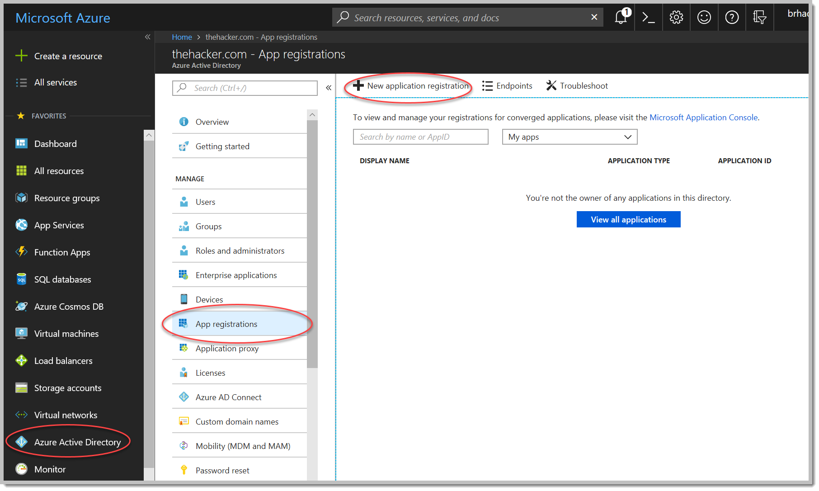
Creating an App Registration

Slide 6
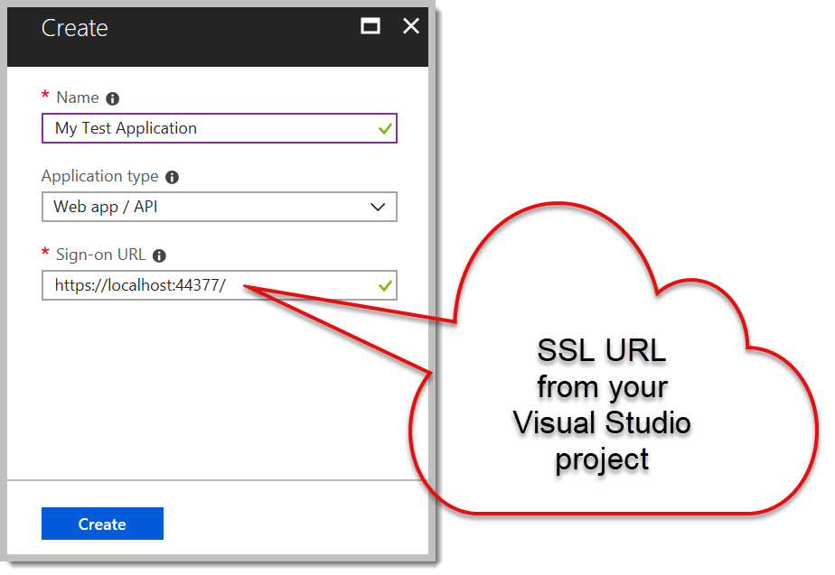
Creating an App Registration

Slide 7
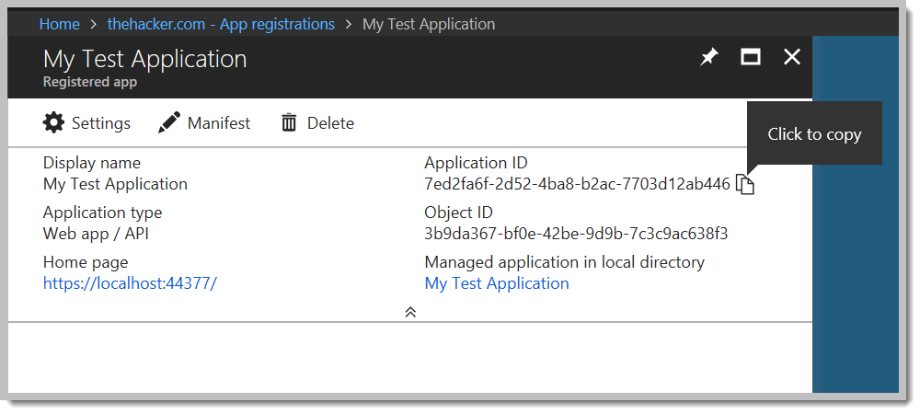
Creating an App Registration

Slide 8
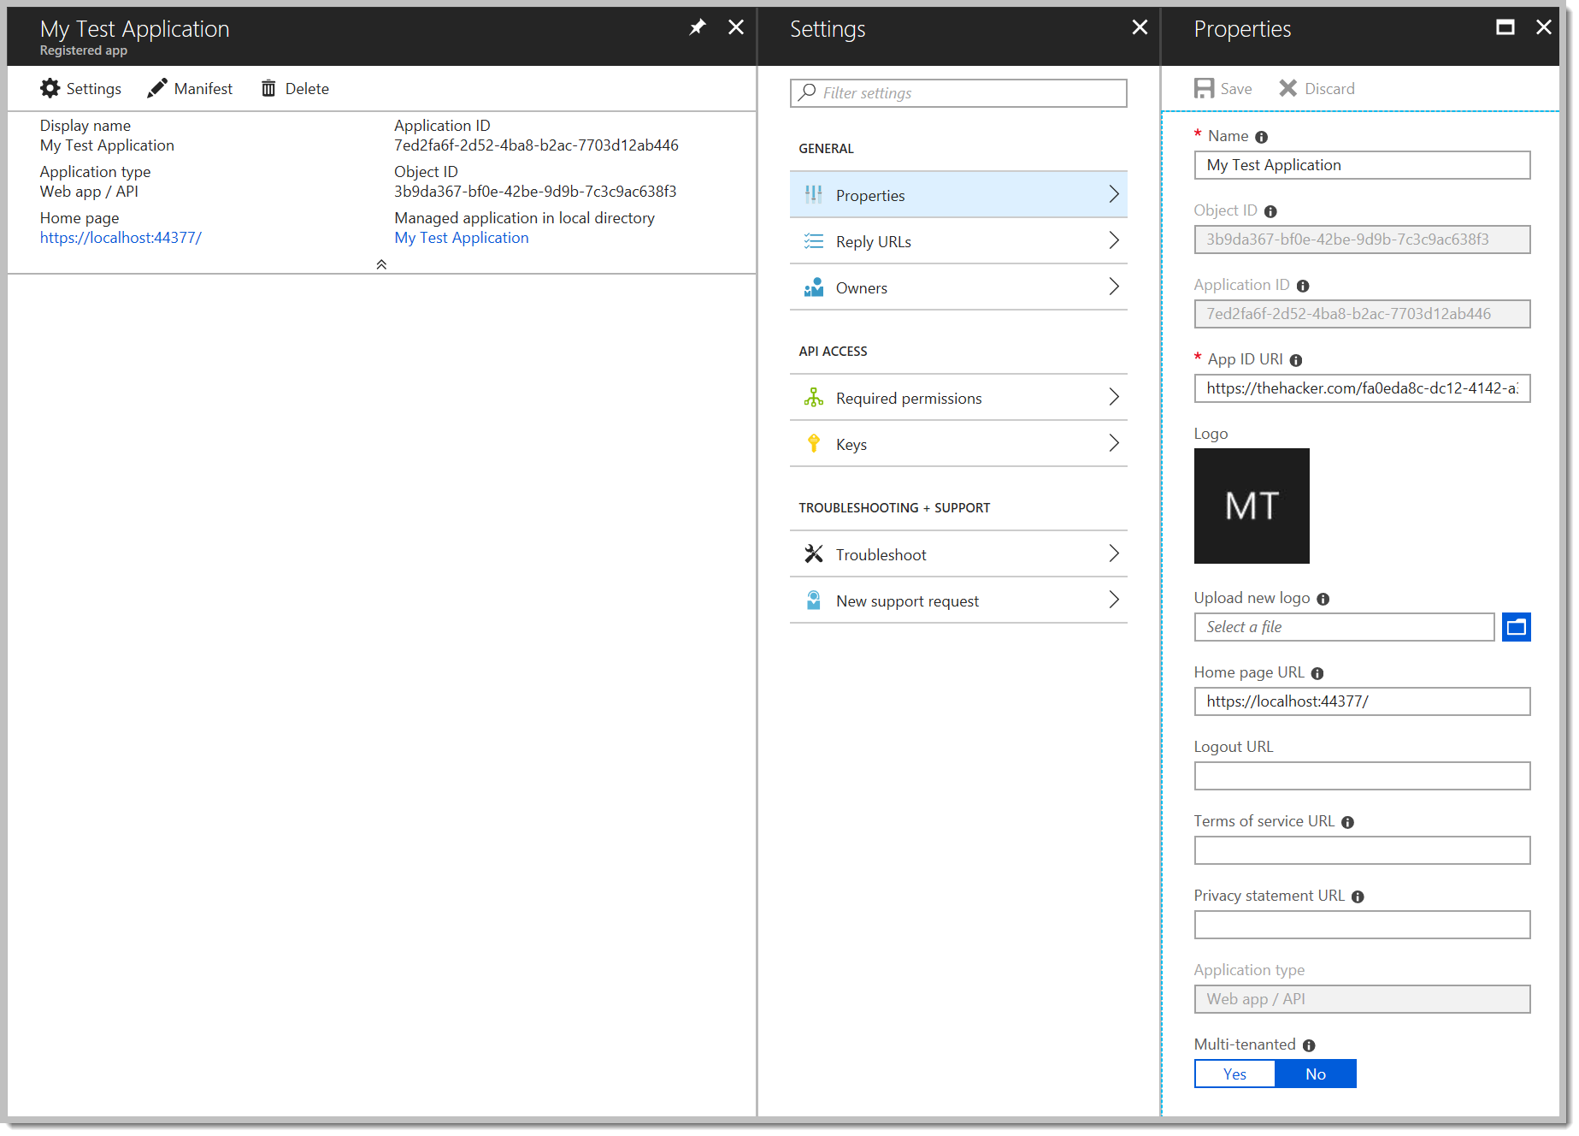
Creating an App Registration - Settings

Slide 9
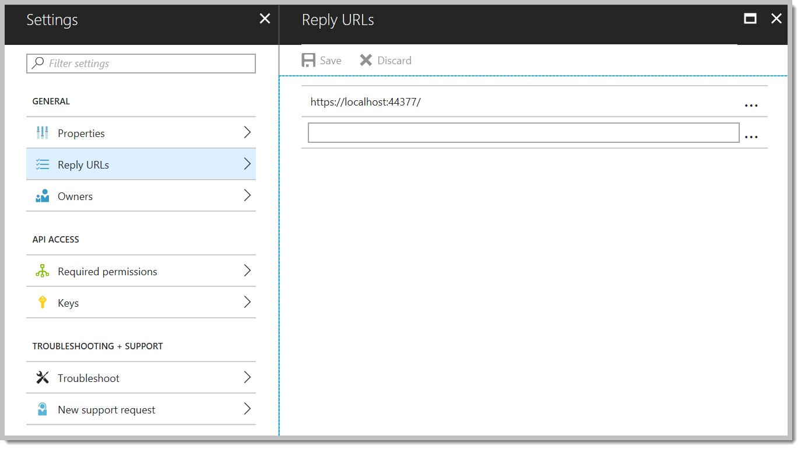
Creating an App Registration – Reply URLs

Slide 10
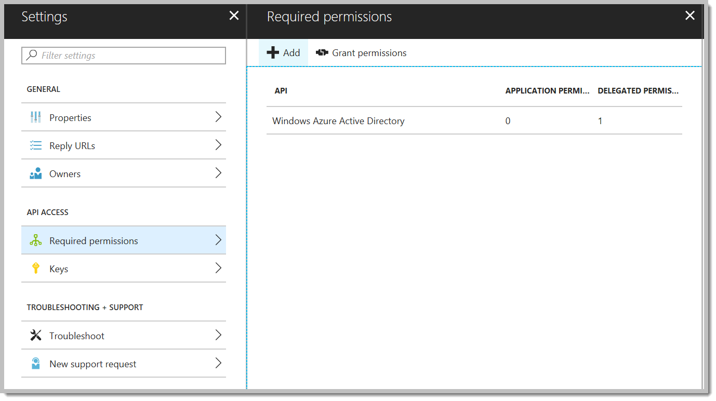
Creating an App Registration – APIs

Slide 11
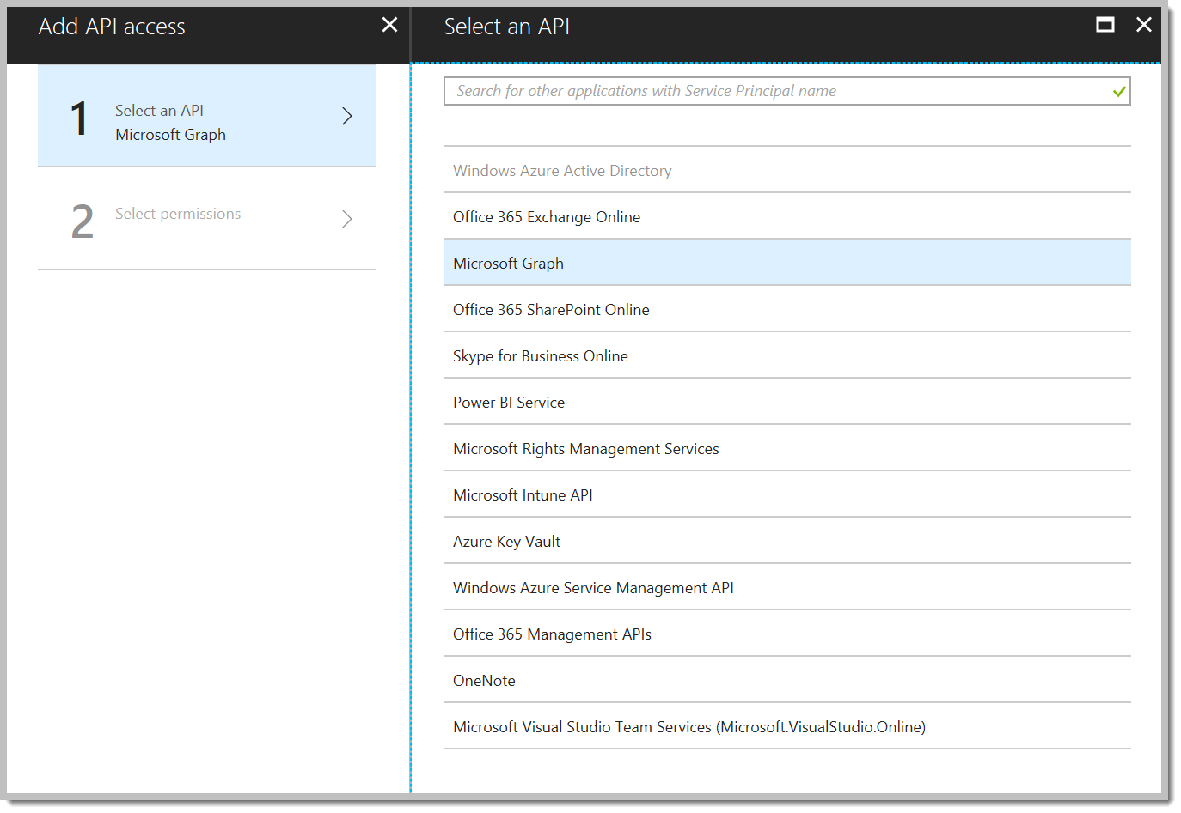
Creating an App Registration - APIs

Slide 12
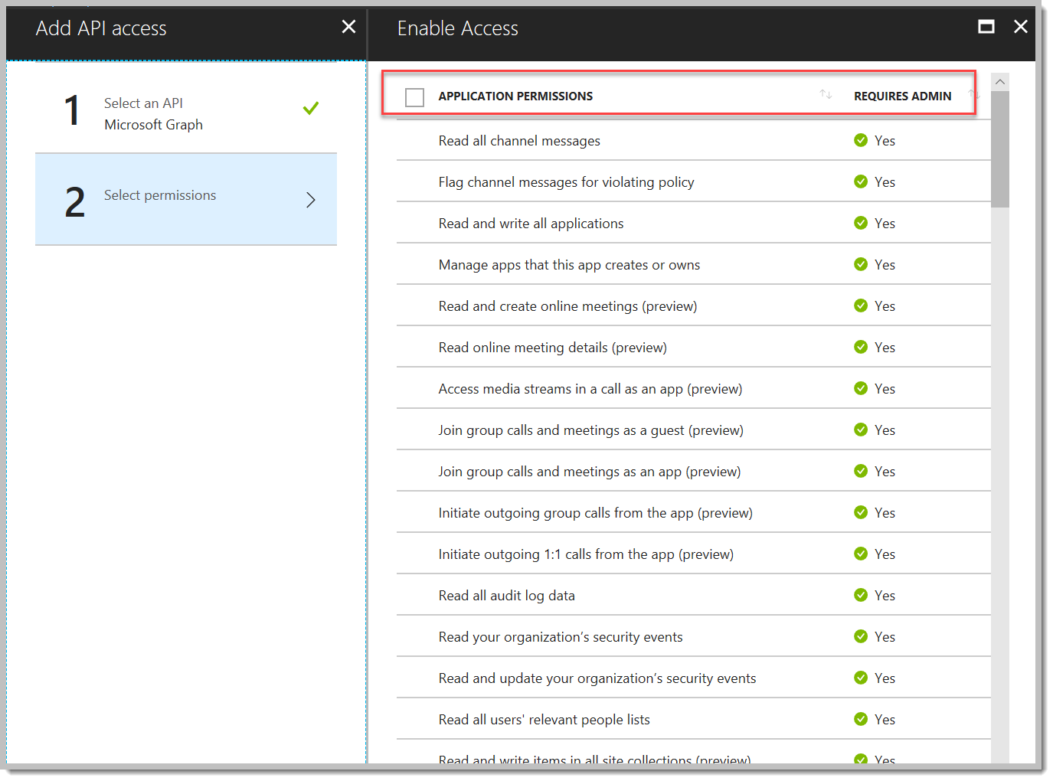
Creating an App Reg – App Perms

Slide 13
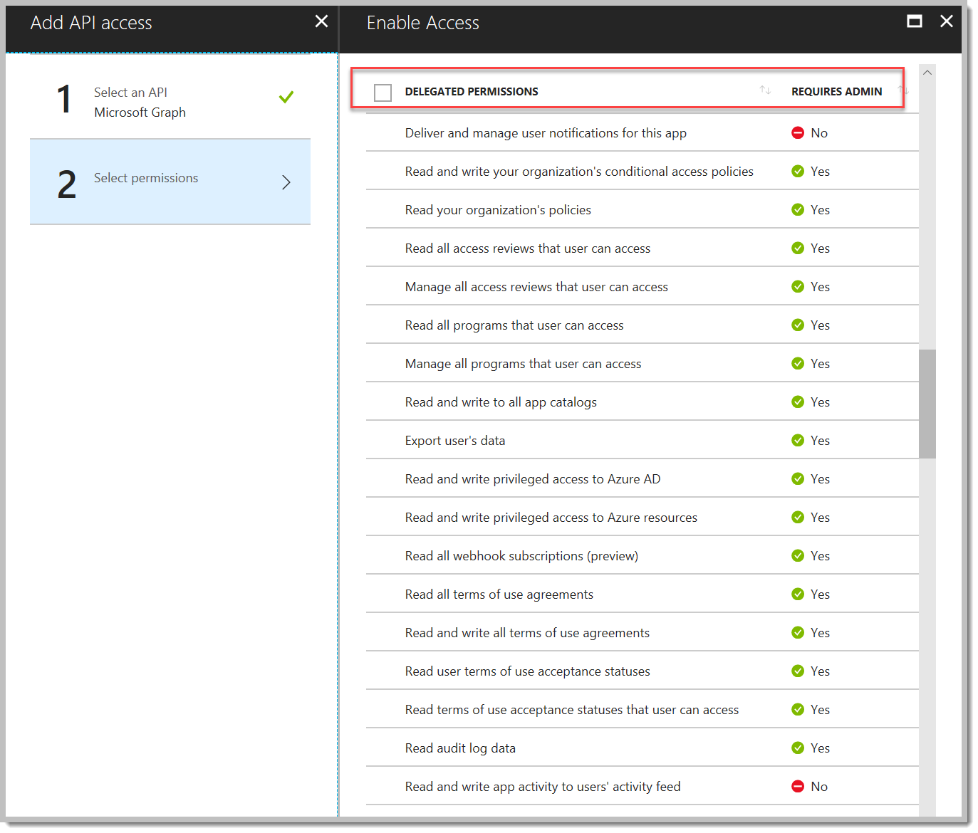
Creating an App Reg – Delegated Perms

Slide 14
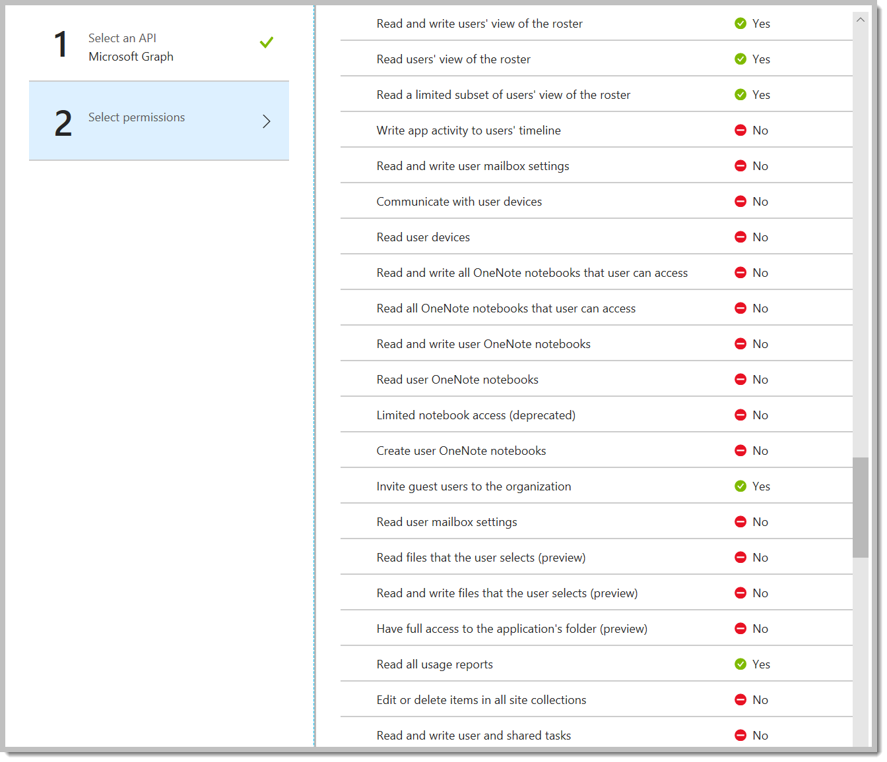
Creating an App Reg – Admin Approval

Slide 15
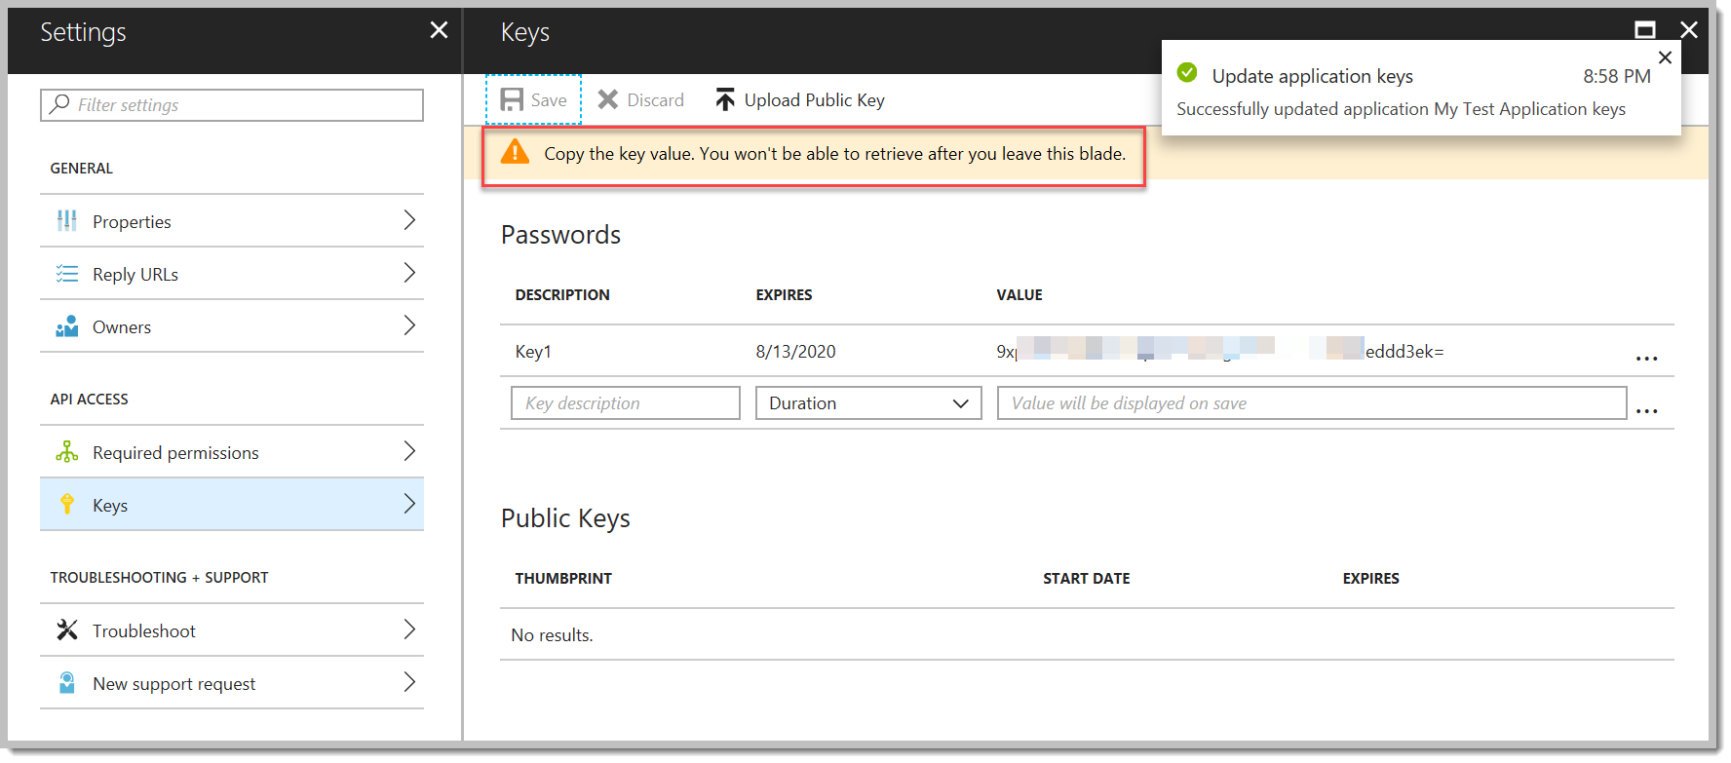
Creating an App Registration – App Keys

Slide 16
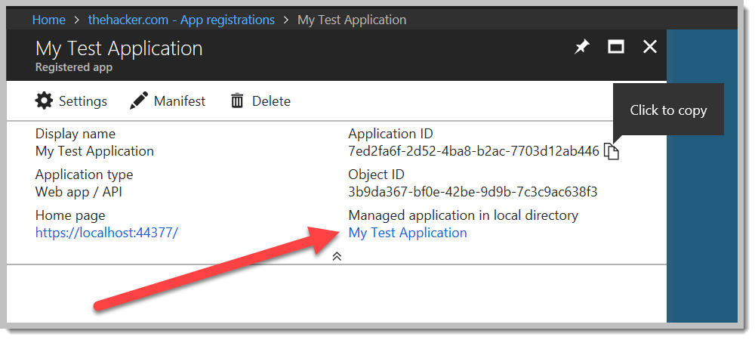
App Registration and Service Principals

Slide 17
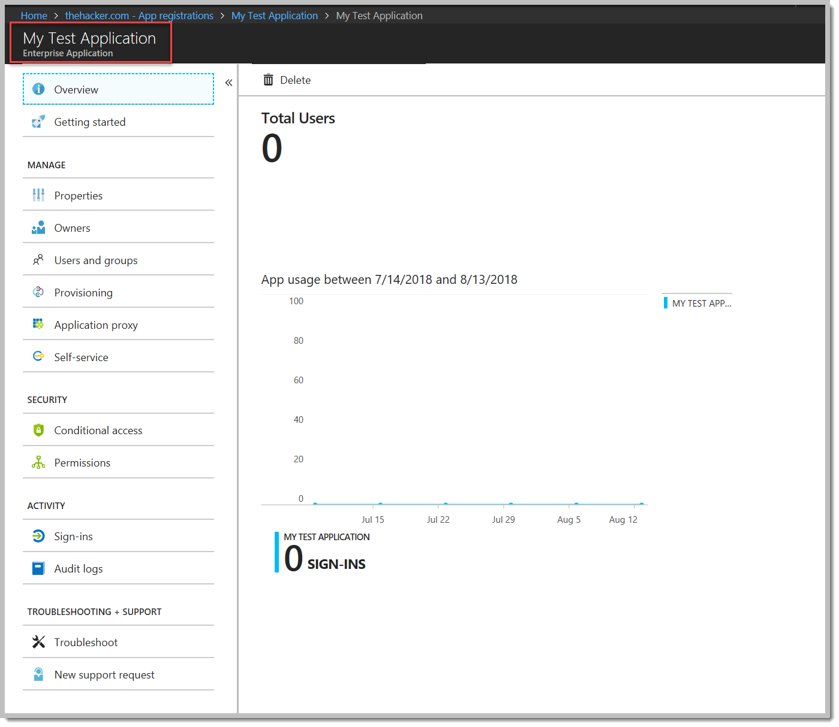
Enterprise Apps - Service Principals

Slide 18
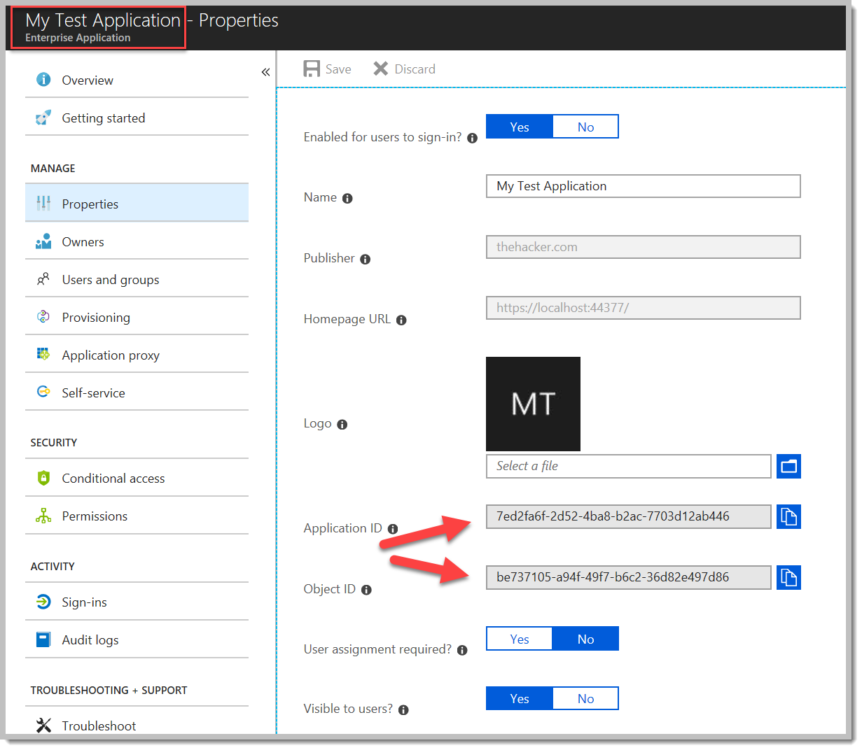
Enterprise Apps - Service Principals

Slide 19
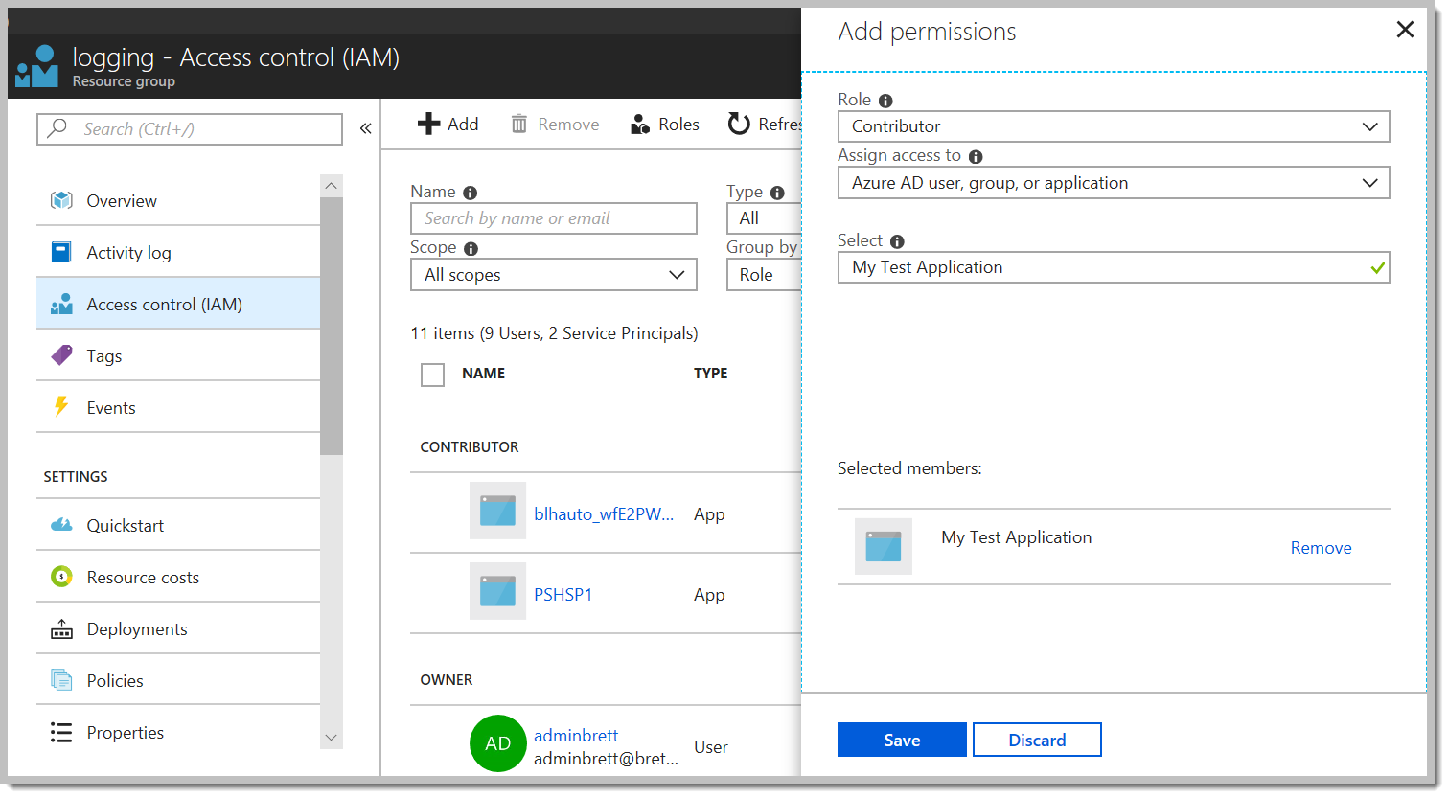
Service Principals and RBAC

Slide 20
Integrating an Application
https://docs.microsoft.com/en-us/azure/active-directory/develop/quickstart-v1-integrate-apps-with-azure-ad
There are quickstart links for ASP.NET, .NET Core, Java, Python, Node, or raw OpenID Connect (regardless of platform or language)
Other quickstarts focus on single-page apps, API development, and mobile apps
https://docs.microsoft.com/en-us/azure/active-directory/develop/quickstart-v1-aspnet-webapp

Slide 21
Minimal Implementation - OWIN
using Microsoft.Owin.Security;
using Microsoft.Owin.Security.Cookies;
using Microsoft.Owin.Security.OpenIdConnect;
using Owin;
using System;
using System.Configuration;
namespace MyApp
{
public class AuthConfig
{
public static void RegisterAuth(IAppBuilder app)
{
var clientId = ConfigurationManager.AppSettings["APP_CLIENT_ID"];
var tenant = ConfigurationManager.AppSettings["AAD_TENANT_ID"];
var authority = $"https://login.microsoftonline.com/{tenant}";
app.SetDefaultSignInAsAuthenticationType(CookieAuthenticationDefaults.AuthenticationType);
app.UseCookieAuthentication(new CookieAuthenticationOptions());
var options = new OpenIdConnectAuthenticationOptions {
Authority = authority, ClientId = clientId, };
app.UseOpenIdConnectAuthentication(options);
}
}
}

Slide 22
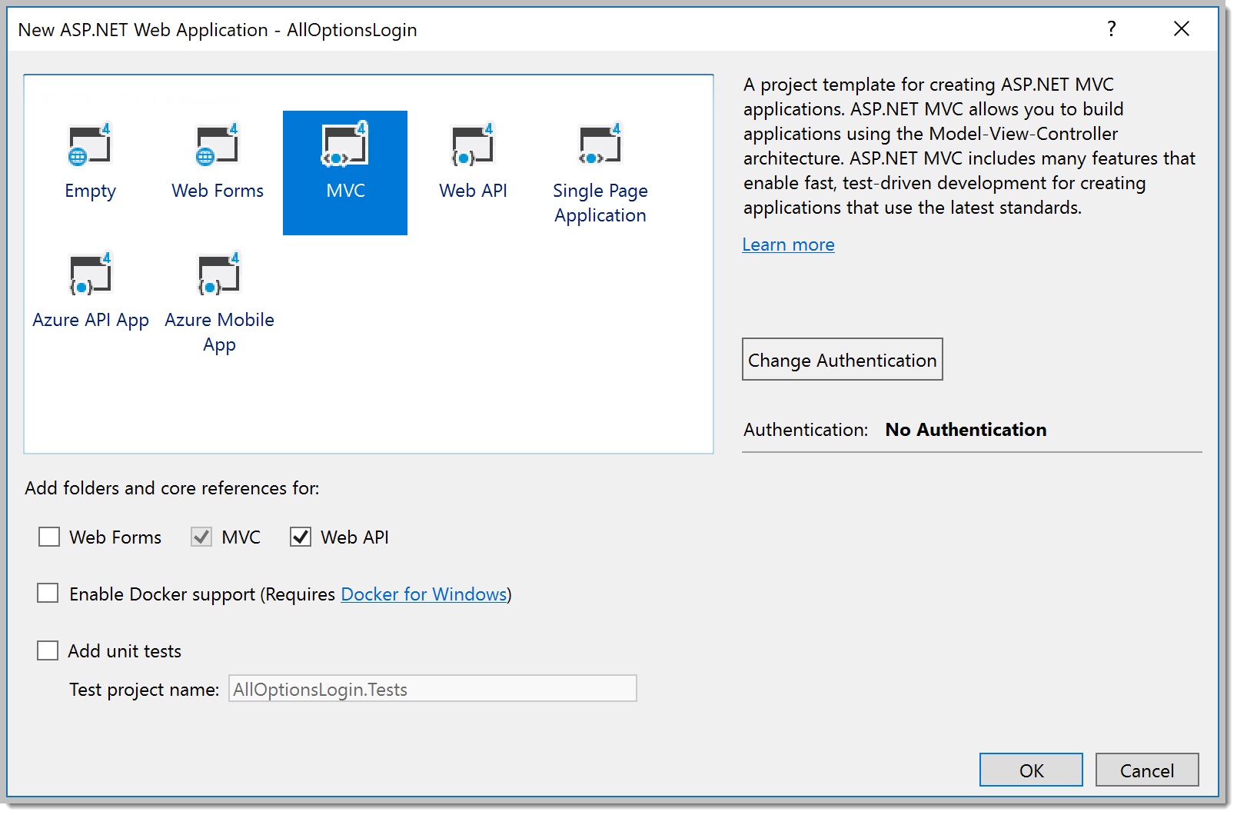
Integrating an Application
Visual Studio Template – New Web Project

Slide 23
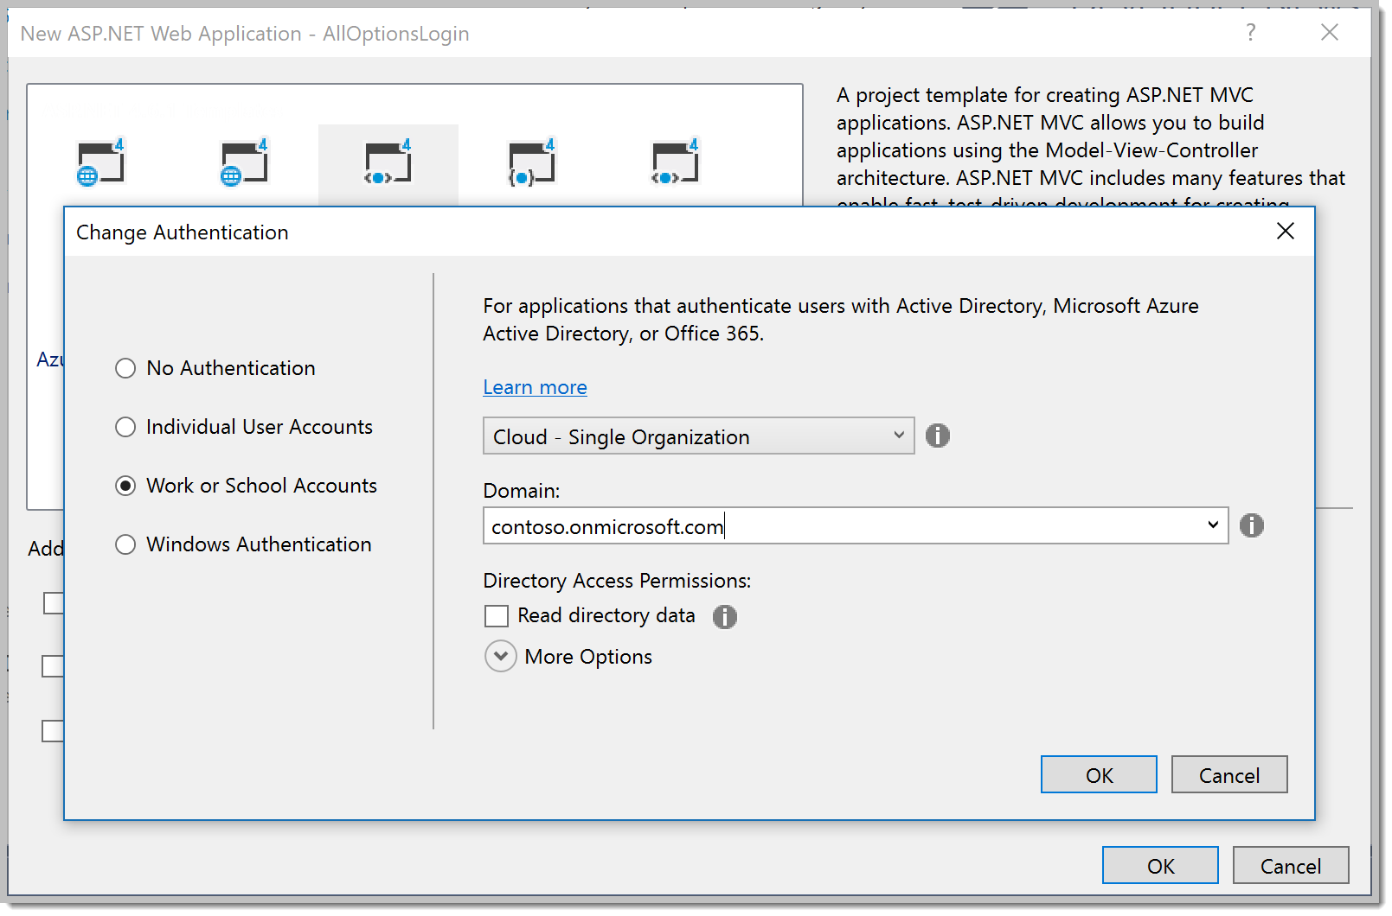
Integrating an Application
Visual Studio Template – New Web Project

Slide 24
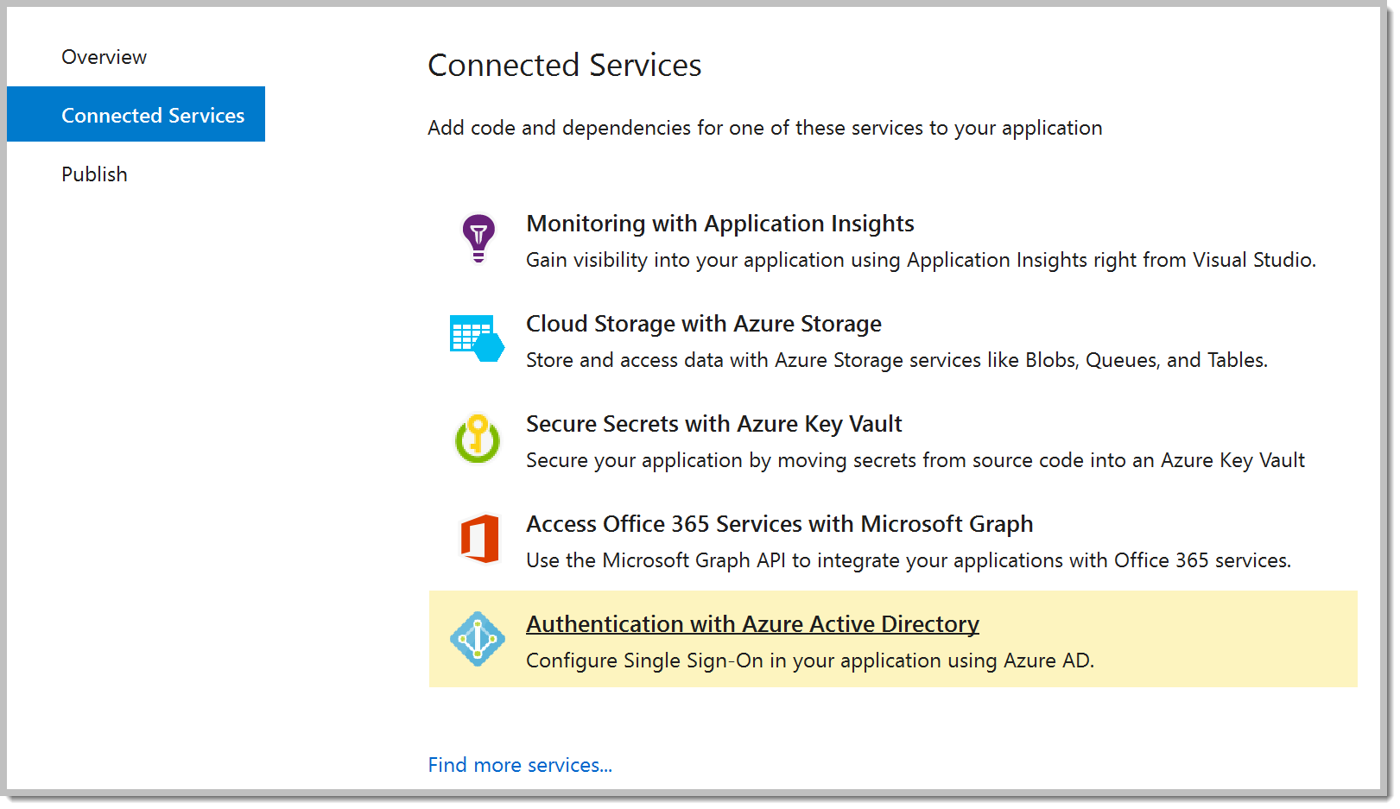
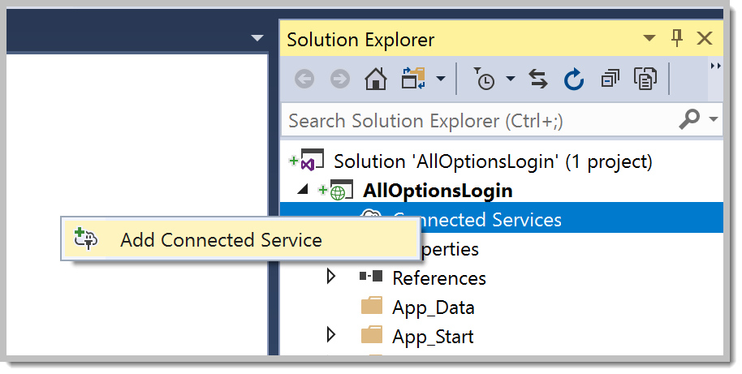
Integrating an Application
Visual Studio Tooling – Existing Project (this is you)

Slide 25
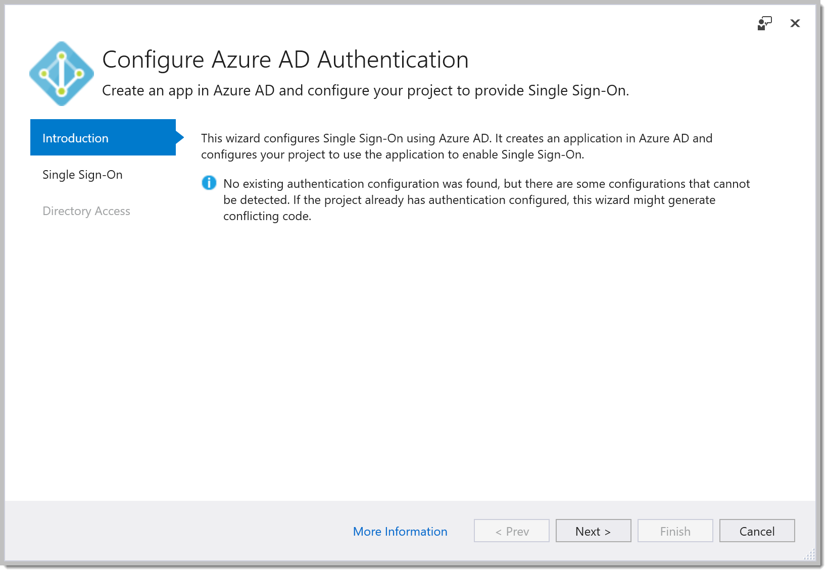
Integrating an Application
Visual Studio Tooling – Existing Project

Slide 26
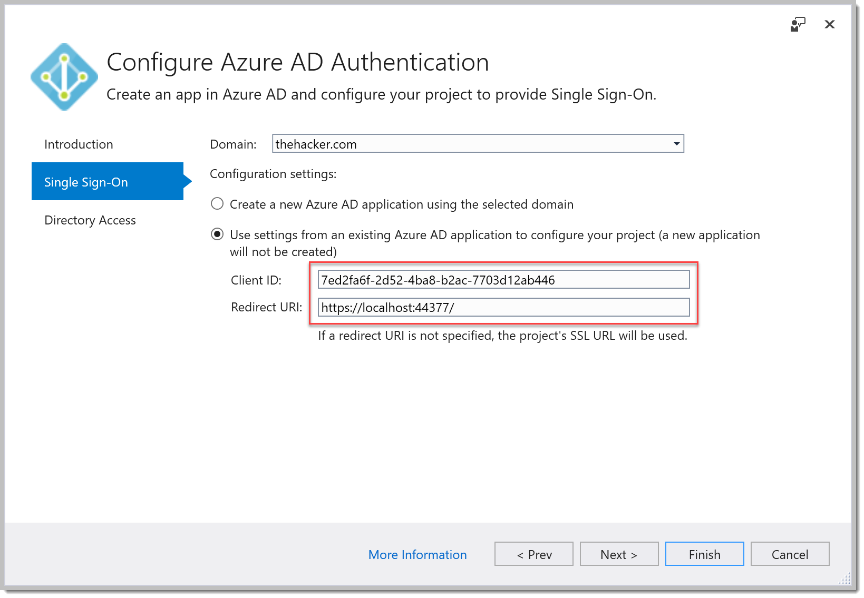
Integrating an Application
Visual Studio Tooling – Existing Project

Slide 27
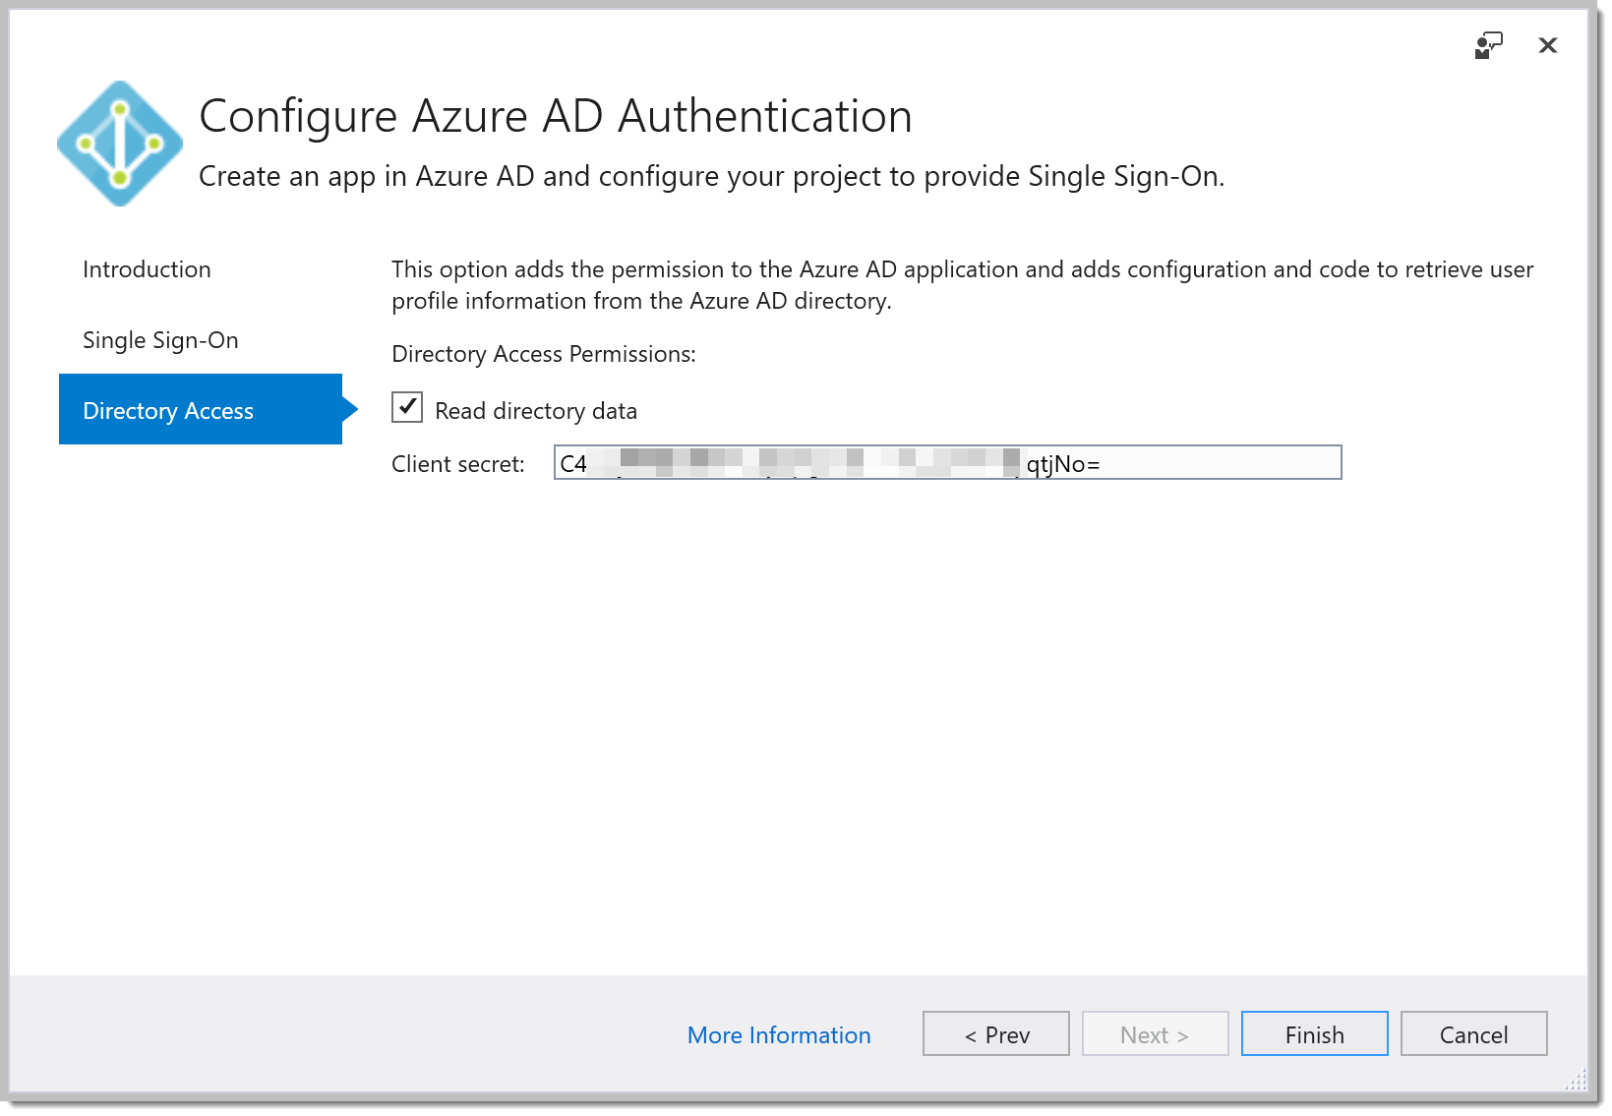
Integrating an Application
Visual Studio Tooling – Existing Project

Slide 28
WHOA…What Just Happened?
NuGet packages installed:
OWIN (Open Web Interface for .NET)
Provides an abstraction layer above the hosting platform, allows pluggable components
OpenID Connect
JWT (Javascript Web Token) support
Active Directory Application Library (ADAL)
Token Cache
This wizard framework installs Entity Framework and SQL – easy to auto-config the schema
Token Cache can be stored using any persistent storage mechanism with encryption at rest and in motion

Slide 29
WHOA…What Just Happened?
Code Updated
Startup classes
Account controller and view
EF classes for the token cache
Web.config settings (pointing to your app registration)

Slide 30
(And One Thing That Didn’t Happen)
As of August 2018, the template wizard doesn’t update the master _Layout view to include a call to the _LoginPartial view. This view notices if you’ve logged in or not, and gives you the link to do so, or welcomes you if you have.
We’ll need add ONE line of code before we continue.

Slide 31
Adding a Line of Code
@Html.Partial("_LoginPartial")
Open \Views\Shared\_Layout.cshtml
Go to the end of line 26
Enter to create a new line, and type the string above

Slide 32
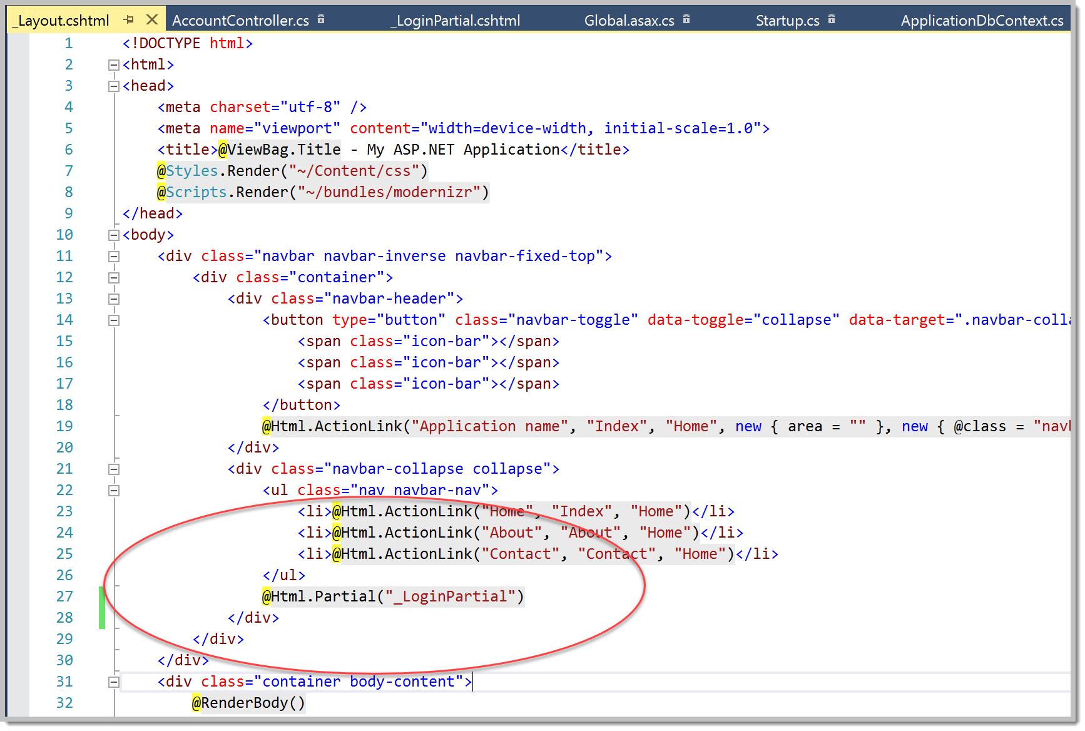
The Result

Slide 33
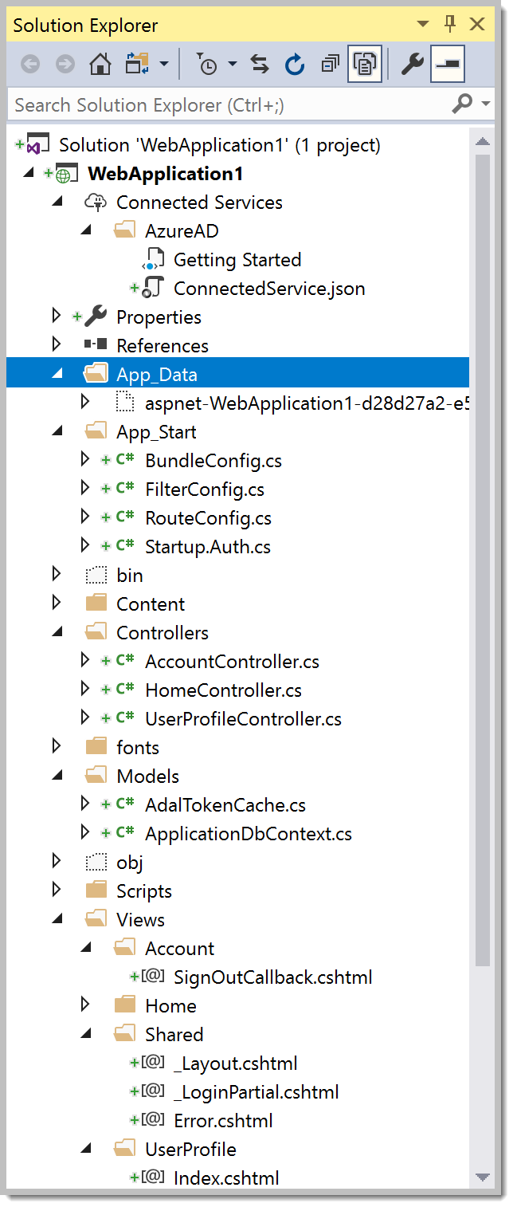
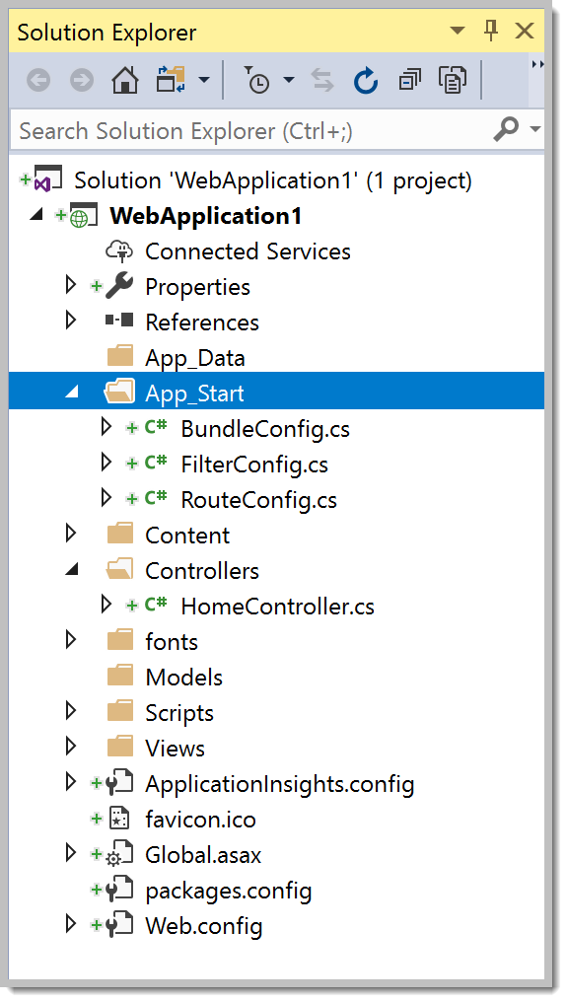
Inspect the Project

Slide 34
Azure AD Consent
Our application had as a default permission, “Sign in and read user profile” from the Windows Azure Active Directory API
When we ran the Azure AD integration wizard, we checked “Read Directory Data”. The wizard, impersonating us, actually added a 2nd required permission to the app.

Slide 35
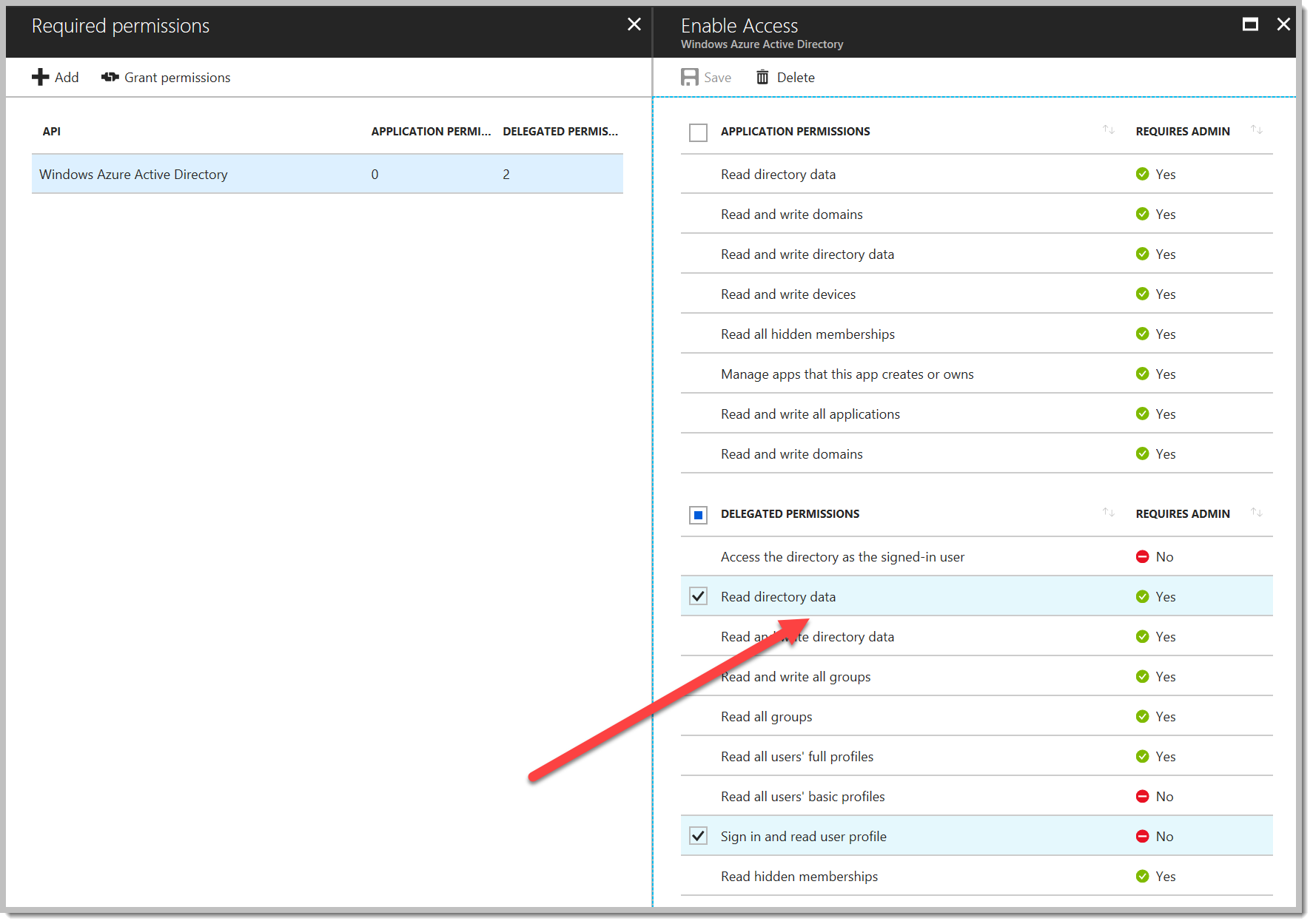
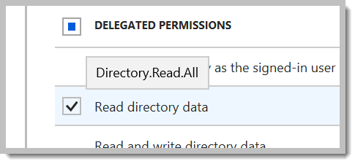
Azure AD Consent

Slide 36
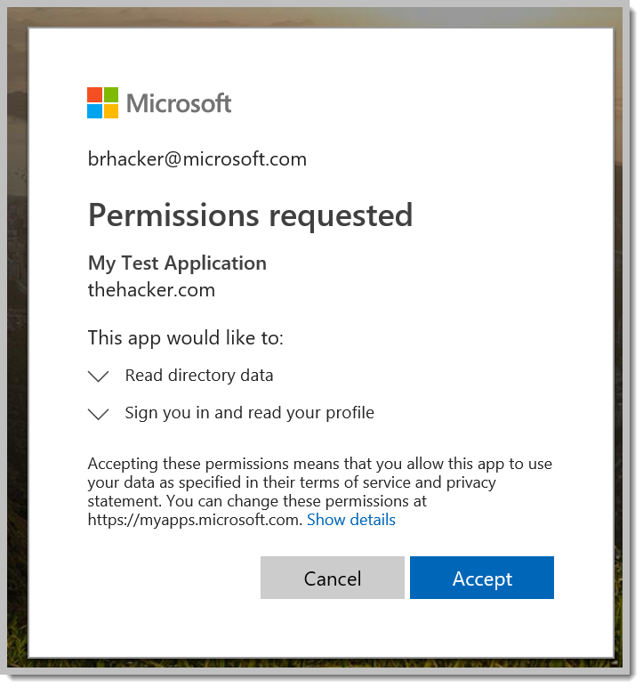
Azure AD Consent
When you first log into the app with your Azure AD app registration, YOU (the user) will have to CONSENT to the applications requested permissions.

Slide 37
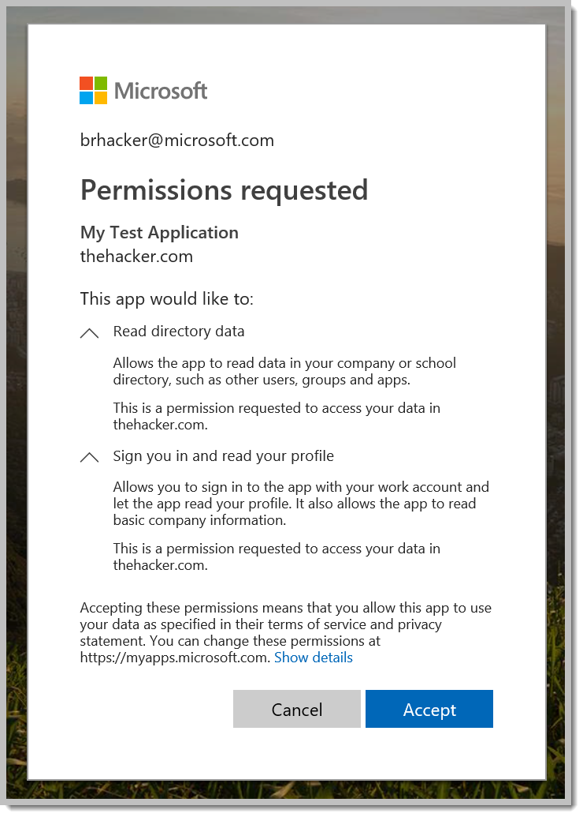
Azure AD Consent
You can click to expand the requested permissions for details.

Slide 38
Run It
(In Visual Studio, hit F5 or click the green “IIS Express” button)

Slide 39
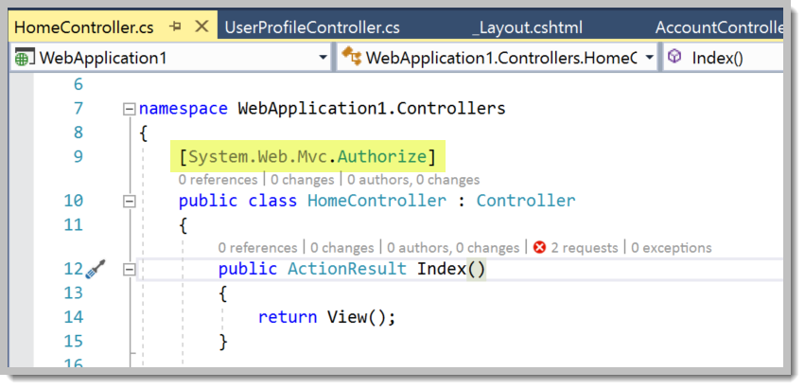
Discussion
Why did it immediately log me in? I didn’t click the Login button.
The Azure AD wizard in VS updated the “Home” controller, which is the code that’s executed when you arrive at “/”. ASP.Net MVC includes built-in integration with OWIN, so that AUTHORIZATION can be enforced to ensure that you’re logged in before you hit the controller.

Slide 40
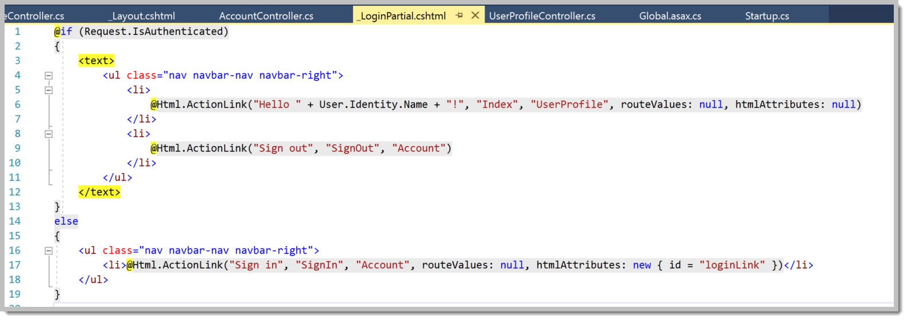
Discussion
Where’s the code that notices if I’m logged in?
It’s the _LoginPartial file we pointed to in our extra line of code.

Slide 41
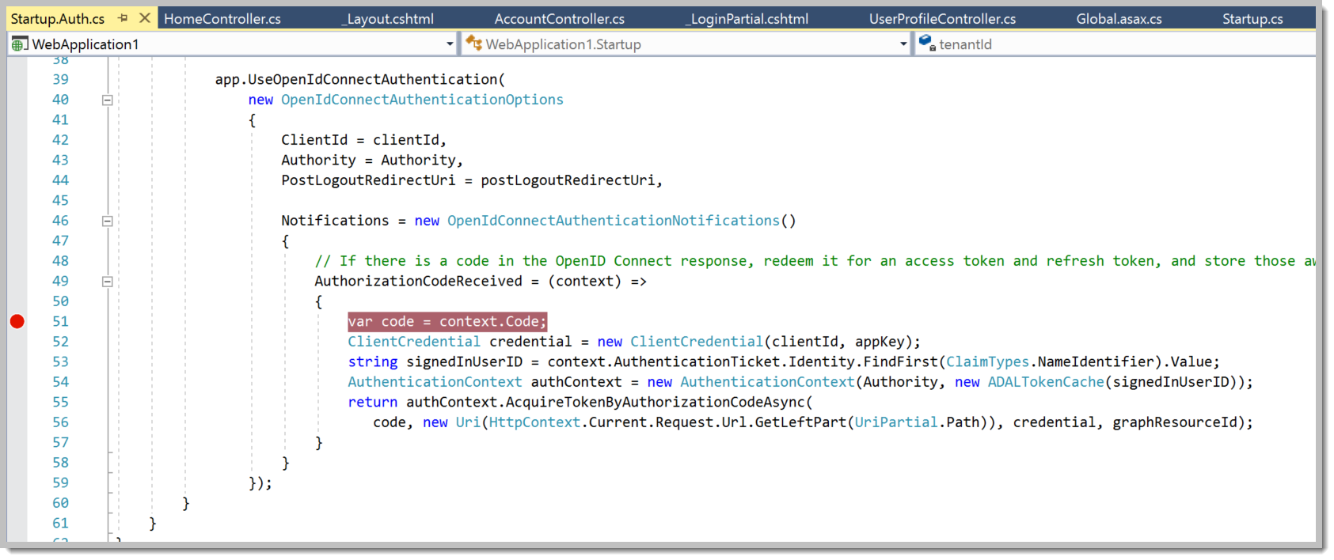
Break Points
Break points allow us to inspect our code while it’s running. Very useful when troubleshooting, and for figuring out what’s going on in the oAuth dance. Let’s watch what happens when we get back from Azure AD. Break line 51 in \App_Start\Startup.Auth.cs:

Slide 42
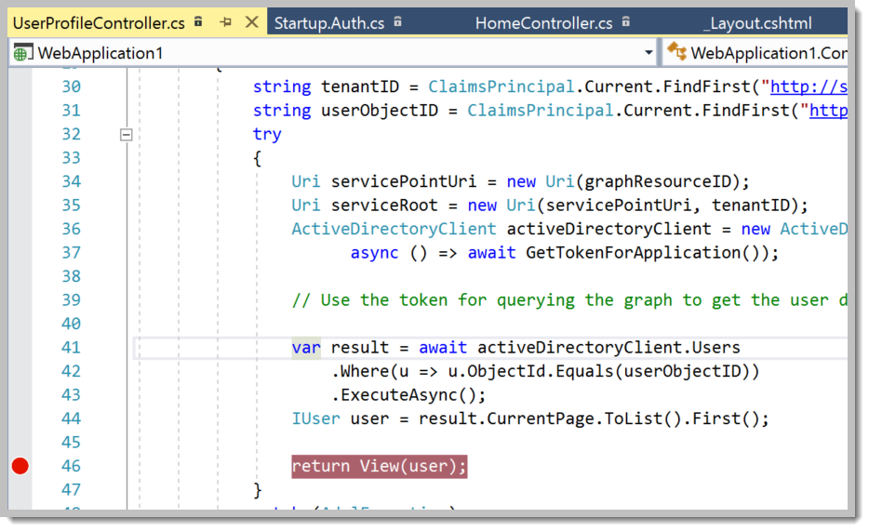
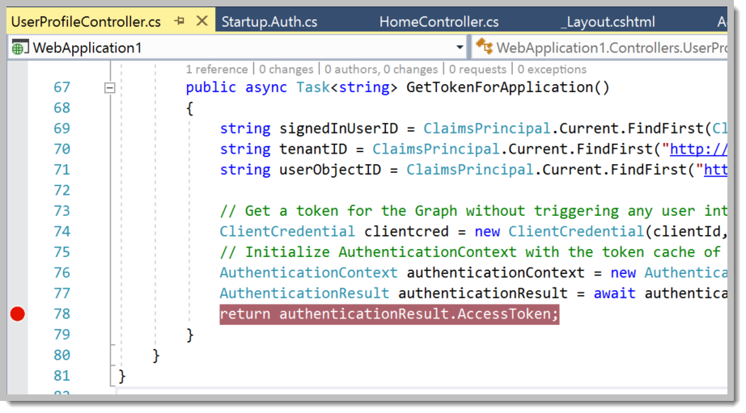
Break Points
Let’s also see what happens when we click to inspect our user profile. The app will make an API call to retrieve the info, then return it to the browser. Break line 46 AND line 78 in \Controllers\UserProfileController.cs

Slide 43
Inspect Login
Click “Sign out” in the top right corner. When you get back, click “Sign in” again. We’ll break inside Startup.Auth.cs
Select the “Locals” tab in the bottom pane. Expand “context”, then “Authentication Ticket”, then “Identity”, then “Claims”, then “Results View”. You might drag the bottom pane up so you can see more.

Slide 44
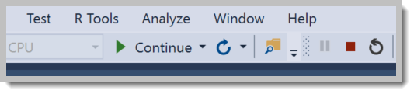
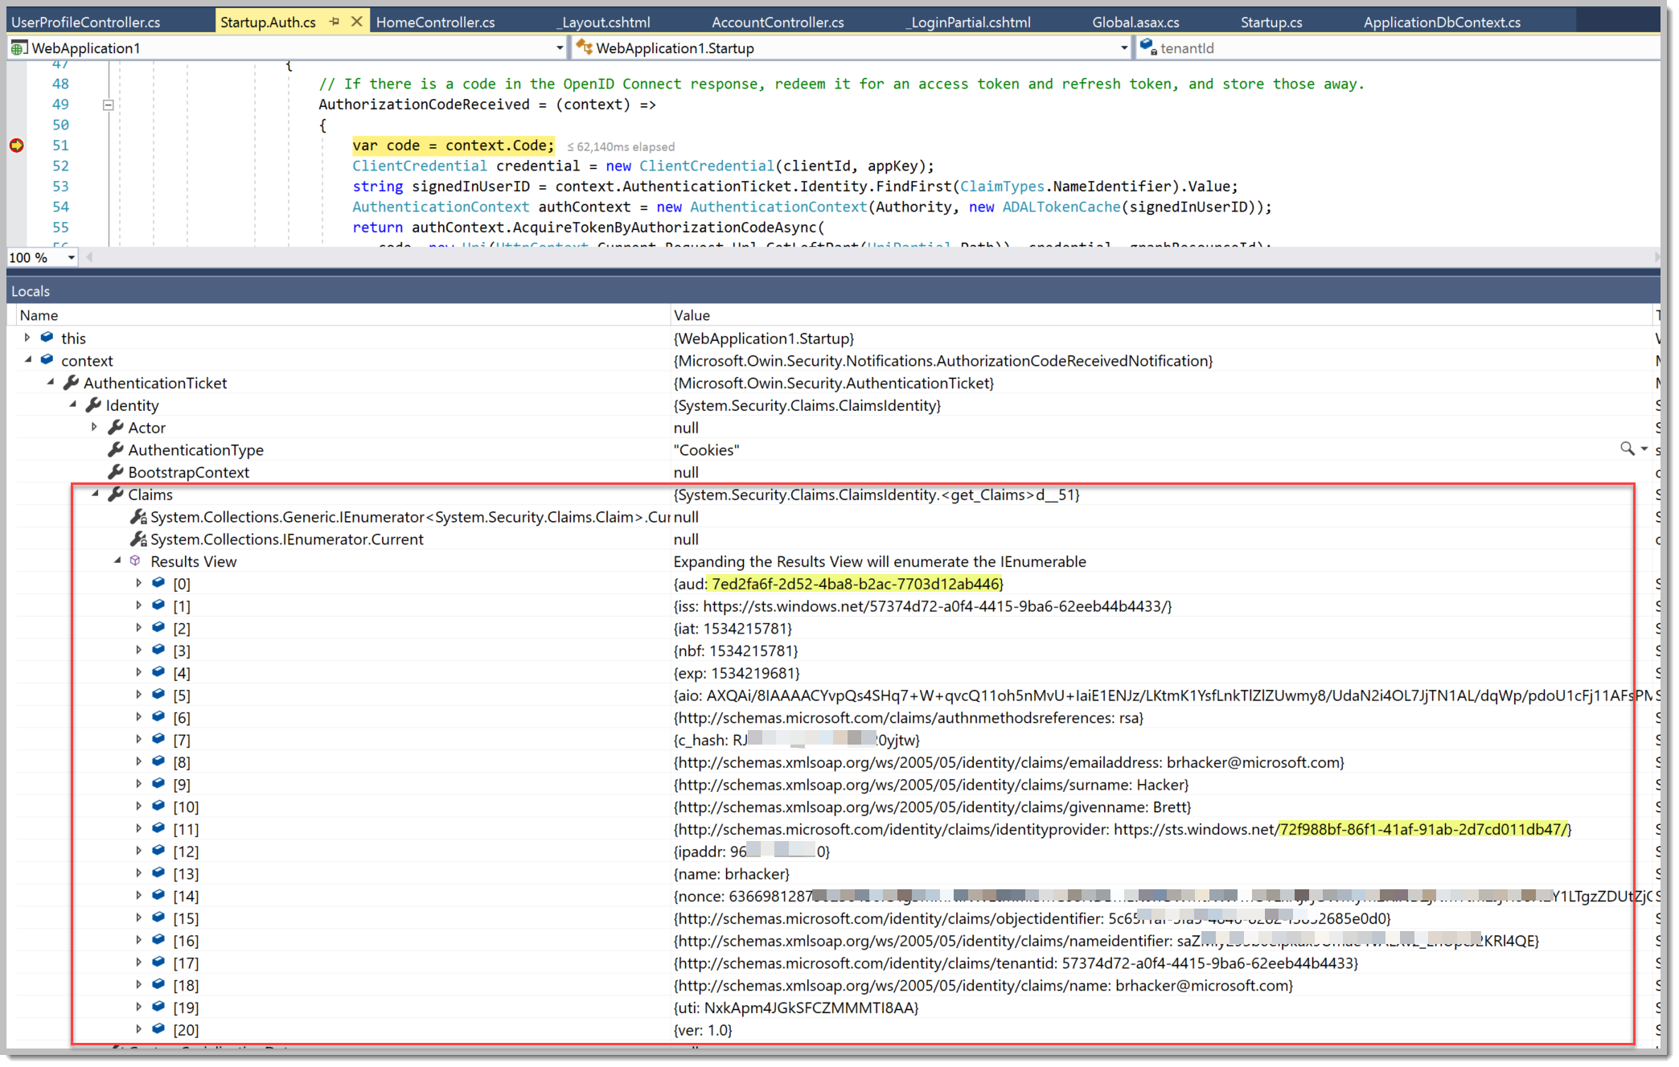
Inspect (then click “Continue”)

Slide 45
Inspect Delegated API Call
If you mouse over your login name in the top right, you’ll see it’s a link to “/UserProfile”.
This controller will take the cached access token we just saved, and use it to make a request back to the tenant for additional information.
When we click, we’ll break and inspect the access token that was just retrieved from the database (mouse over “.AccessToken” on line 78).
Hit F5 to continue to the next break, where the API call has just returned with the information.
In the “Locals” pane again, expand “user”. We have a ton of information from our user record in the tenant.

Slide 46
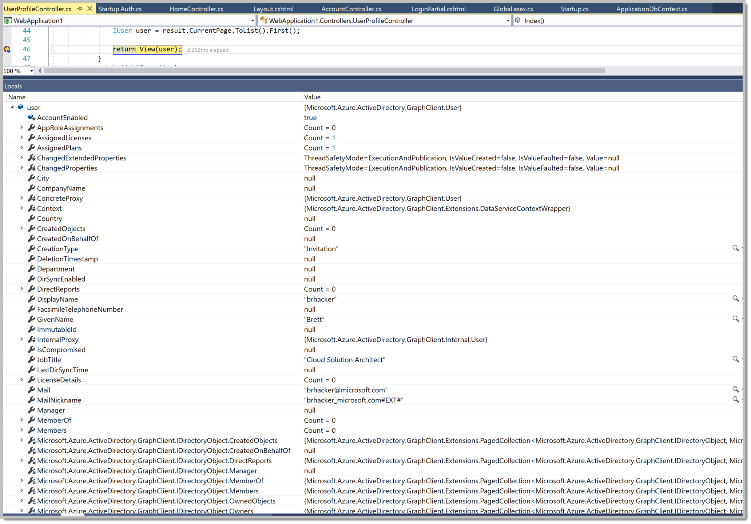
Inspect (then click “Continue”)

Slide 47
Things To Explore
Inspect the “user” object after the API call again. Identity one or two other attributes (job title, city, etc.) that you’d like to display on your User Profile page.
Update your user object in Azure AD via the Azure portal - set the job title, city, etc.
In \Views\UserProfile\Index.cshtml, see how the code is structured to pull in DisplayName, GivenName, and Surname. Add a couple of extra rows and display the additional attributes you selected and updated above.

Slide 48
Prerequisites
An IDE
Visual Studio 2017/2019
VS Code
Notepad?
These activities can be performed in any development environment, using any language or platform
Someplace to host your app
Azure, Azure Stack, the IDE debugger…
No fear

Slide 49
Choose your environment
https://github.com/Microsoft/identity-dev-lab
ASP.Net
ASP.Net Core
Java
Angular
Other samples available:
https://docs.microsoft.com/en-us/azure/active-directory/develop/index
Android, iOS, UWP, NodeJS, Python, AngularJS

Slide 50
References
Links:
https://docs.microsoft.com/en-us/azure/active-directory/develop/quickstart-create-new-tenant
https://account.windowsazure.com/organization
https://docs.microsoft.com/en-us/azure/active-directory/develop/quickstart-v1-integrate-apps-with-azure-ad
https://docs.microsoft.com/en-us/azure/active-directory/develop/quickstart-v1-aspnet-webapp

